Slide 1


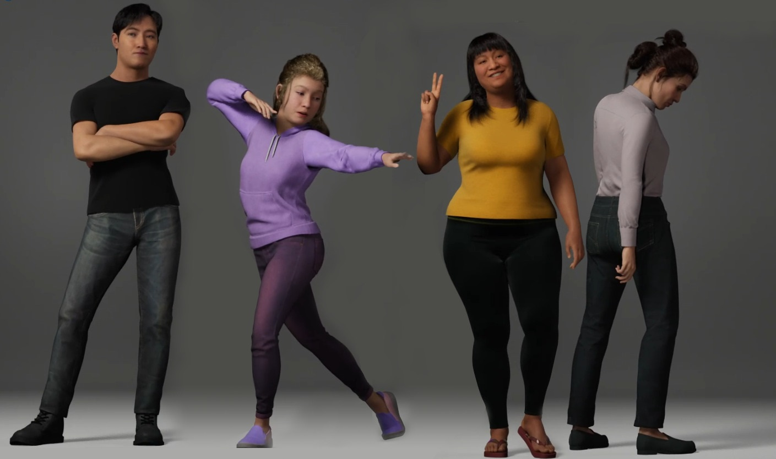

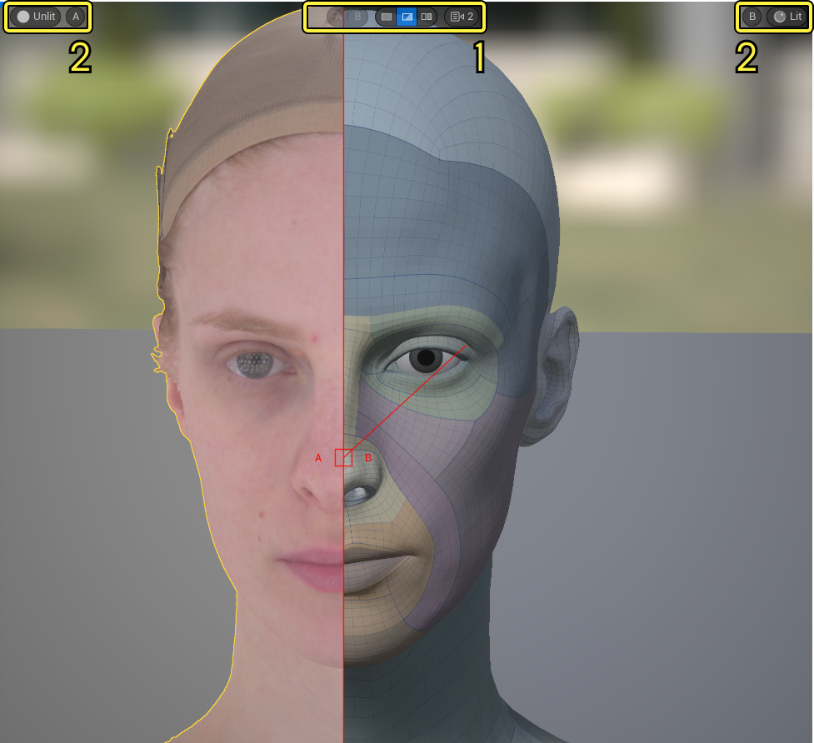

Digital Humans
Building
AI data Products
Les 05
hr.nl/ai

Slide 2


Slide 3
Main Deliverable
individual digital human AI Report on:
A real-life machine learning use-case
of an existing data product solution
A data product is any application or tool
using data science combined with algorithms
---required by the AI-model---
that autonomously aids businesses (profit or non-profit)
to provide a solution to a given societal problem
solely based on sampling data.

Slide 4
[AI] data product
comprises a human-centered interface,
creating meaningful insights derived
from data science principles & methodologies such as:
Human Factors
Predictive Analytics
Descriptive Data Modeling
Data Mining
Machine Learning
Risk Management
Advanced statistics
Predictive Modeling
Natural Language Processing

Slide 5
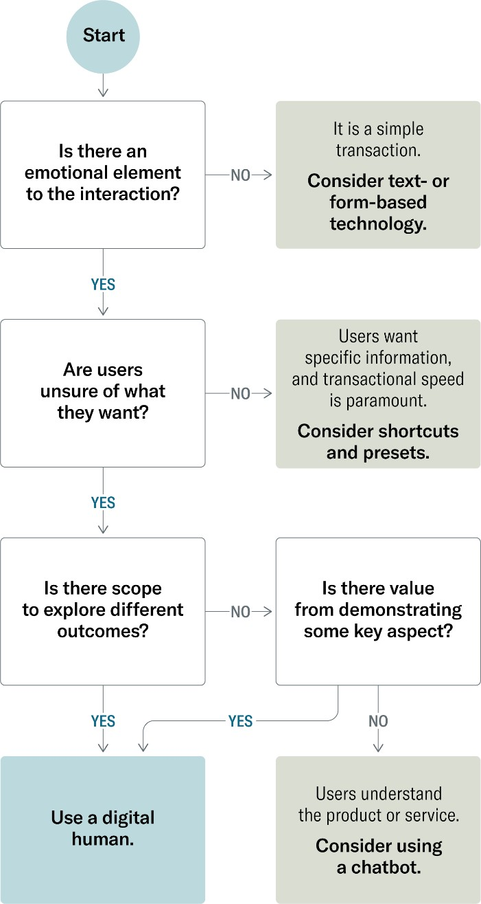
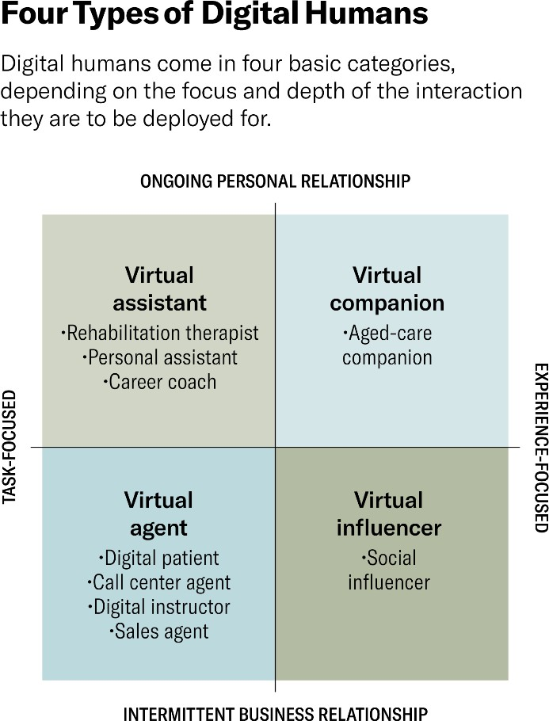
When Should You Deploy Digital Humans?
Bron: Harvard Business Review (April 2023): AI with a Human Face. The case for—and against—digital employees by Mike Seymour, Dan Lovallo, Kai Riemer, Alan R. Dennis, and Lingyao (Ivy) Yuan https://hbr.org/2023/03/ai-with-a-human-face

Slide 6



HUMAN FACTORS
DATA SCIENCE
DATA PRODUCT

Slide 7
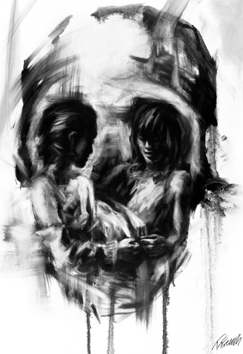
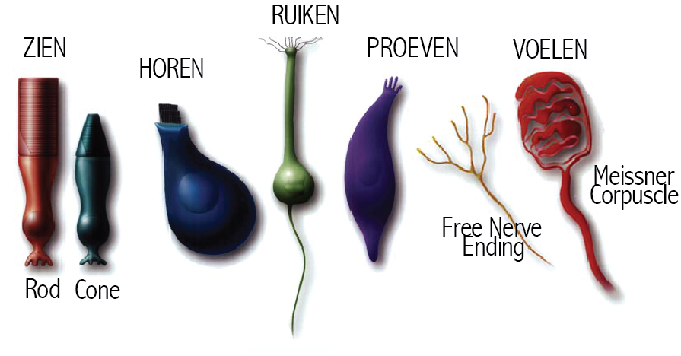
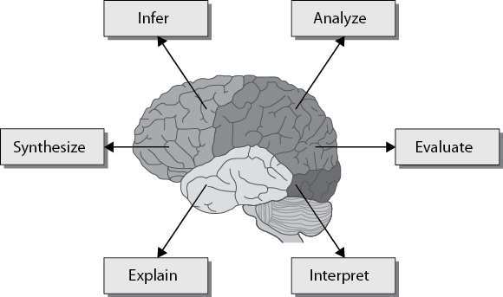

HUMAN FACTORS
De mens als maatstaf der dingen
NEUROETHOLOGIE
Neuro-ethologisch perspectief: wat maakt ons humaan?
Gewaarwording & Perceptie
Cognitie & Semiotiek
Gedrag & Communicatie
Theory of Mind (ToM)
Biologie / neuro-wetenschappen
Biologie / Neuro-wetenschappen
Biologie / Psychologie
Psychologie /
Sociologie

Slide 8


It is a form of interaction
The activity of abstracting is basically a form of interaction between people in which they simplify the complexity of their own ordinary, everyday interactions […] in an effort to make meaning of what they are doing […].
– Ralph Stacey
Complexity and Organizational Reality

Slide 9
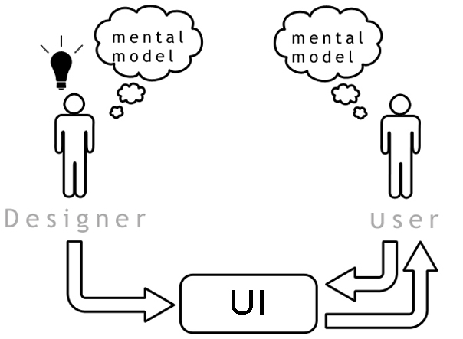



Slide 11
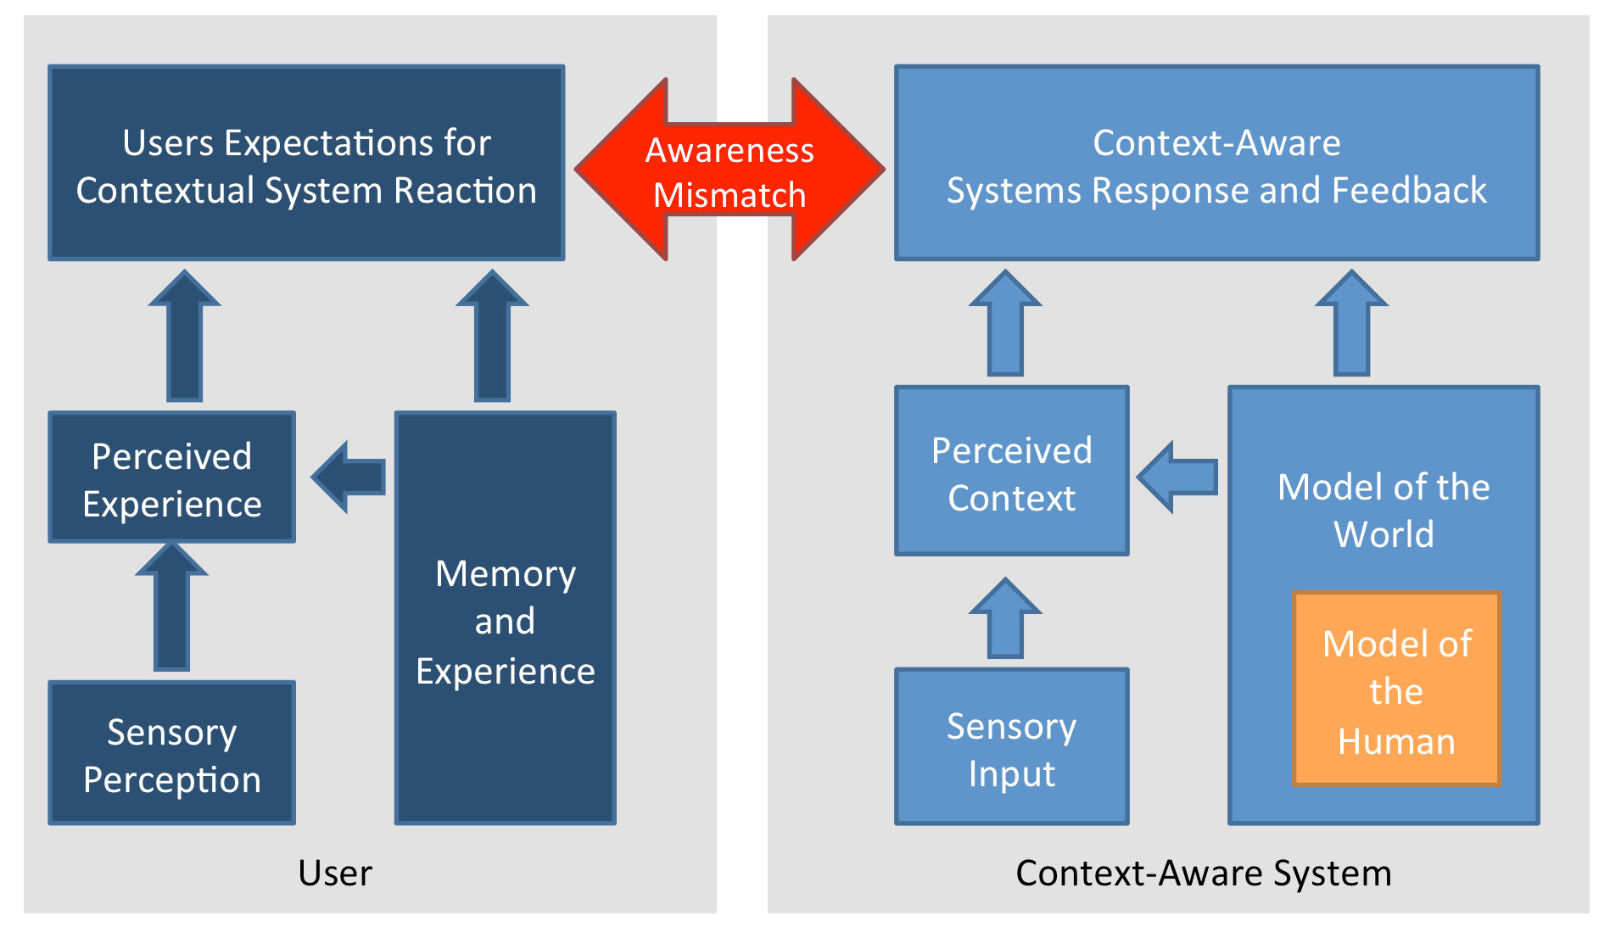
XOR Puzzle!

Slide 12
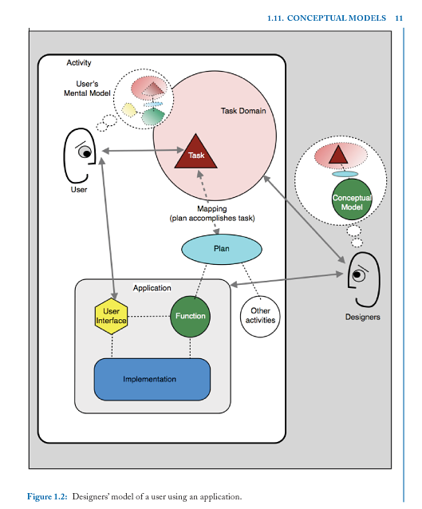
XOR Puzzle!

Slide 13
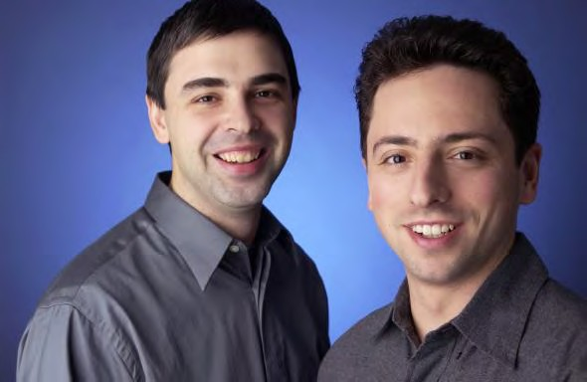

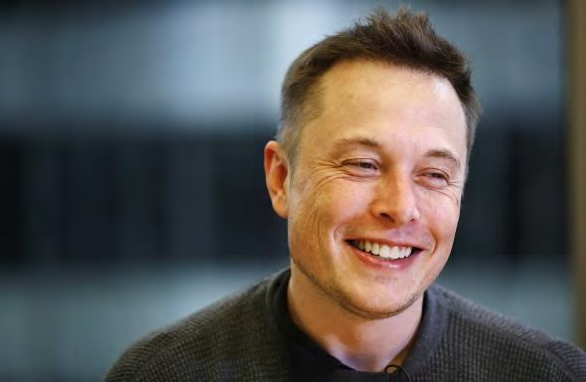




What do these people have in common?
{02}
Data Science

Slide 14
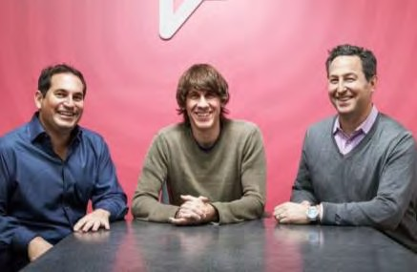

{02}
Data Science
Big-Tech is build upon data [products]

Slide 15
{02}
Data Science
Simple Predicting Machine
Data Product a definition:
Products fueled by data and machine learning
can be a powerful way to solve users’ needs.
Prime examples include:
Google-search
Amazon product recommendation
Tesla?
Facebook?

Slide 16
{02}
Data Science
Simple Predicting Machine
Data Product a definition:
Products fueled by data and machine learning
can be a powerful way to solve users’ needs.
Prime examples include:
Google-search
Amazon product recommendation
Tesla?
Facebook?

Slide 17



Data products types
{02}
Data Science
Type I
Type II
Type III
Data as a Service
Data-enhanced Products
Data as Insights
› Weather data
› Autonomous driving
› Marketing planning

Slide 18
{02}
Data Science
Simple Predicting Machine
Data Product (top- down)taxonomy:
automated decision-making
decision support
algorithms-as-a-service
derived structured data
raw unstructured data

Slide 19
{02}
DATA SCIENCE
TYPES of DATA PRODUCTS
Sort items into predefined classes
Estimate a numeric value at a specific time
Predict the behaviour of a value in the future
Sort items into similar groups
Recommend items to users
Generate artificial text
Choose from alternative strategies, acting on feedback
Choose from alternative strategies, acting on existing data
Outlier detection
Estimate the probability of an event happening
Rank items to prioritize human action
https://queirozf.com/entries/11-types-of-data-products-with-examples#1-sort-items-into-predefined-classes

Slide 20

DIGTALE IMPLEMENTATIE
Digital human
GAME ENGINE
MetaHumanTutorial-how to use the DSK
https://docs.unrealengine.com/5.2/en-US/using-dialogue-voices-and-waves-in-unreal-engine/
https://www.unrealengine.com/marketplace/en-US/item/66b869fa0d3748e78d422e59716597b6

Slide 21
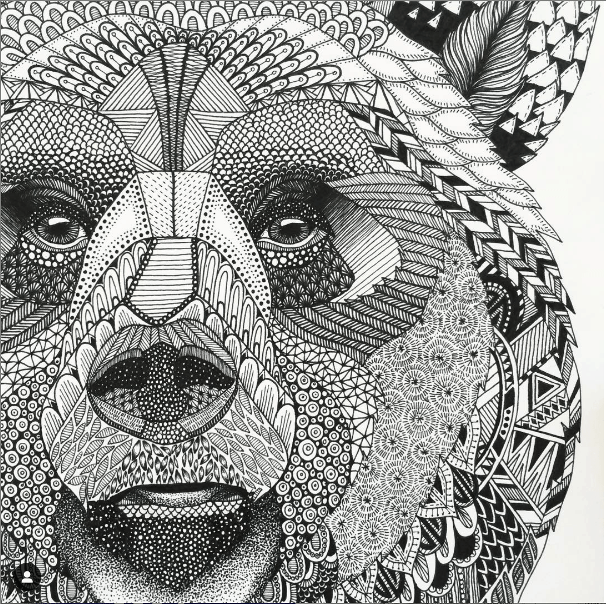
Do it Yourself
Describe by means of a conceptual model
what kind of data-product you to build or explain.
Must contain a description of:
Data description
Model description (type of DATA VIZ)
(learning)algorithm
See also: https://github.com/robvdw/RCA_AIG_042Q6_ARTIFICIAL_INTELLIGENCE

Slide 22
Digital Human as a data product
Defining Digital Human as a Conversational Agent (in your own words)
What AI problem/use-case does it solve? / Is it a good fit?
Designate the Capability Domain & Application Domain
Description of Data Product Components & Techniques Involved
Describe ===>
Graphical User-interfacing
Multimodal (audio-visual) Appearance / Look & Feel
AI-model in terms of its Agency and Architecture
learning algorithm (LM)
how it is trained
the parameters involved

Slide 23
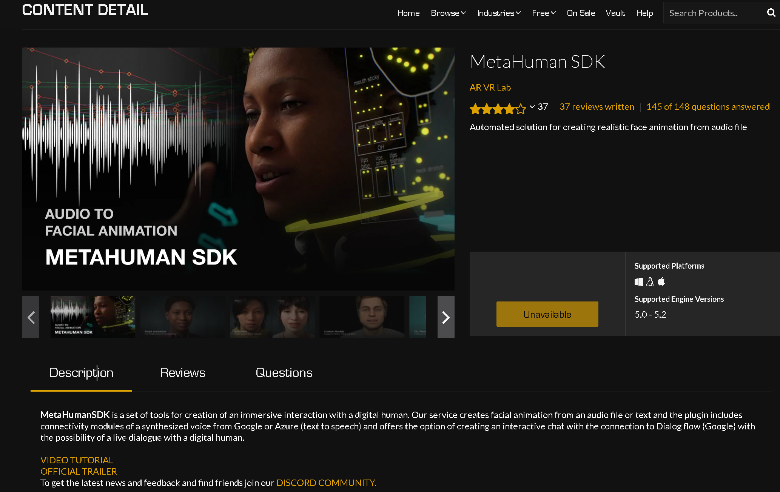
Defining Digital Human as a Conversational Agent
Data Product
Conversational Agent Concept
Lip-synced
life-like “digital Human”
The Key to Diverse Applications
of AI-generated Characters
https://www.unrealengine.com/marketplace/en-US/item/66b869fa0d3748e78d422e59716597b6

Slide 24
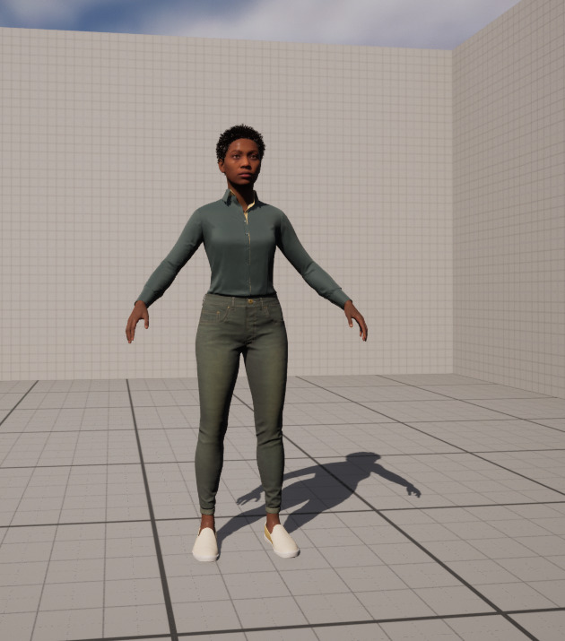
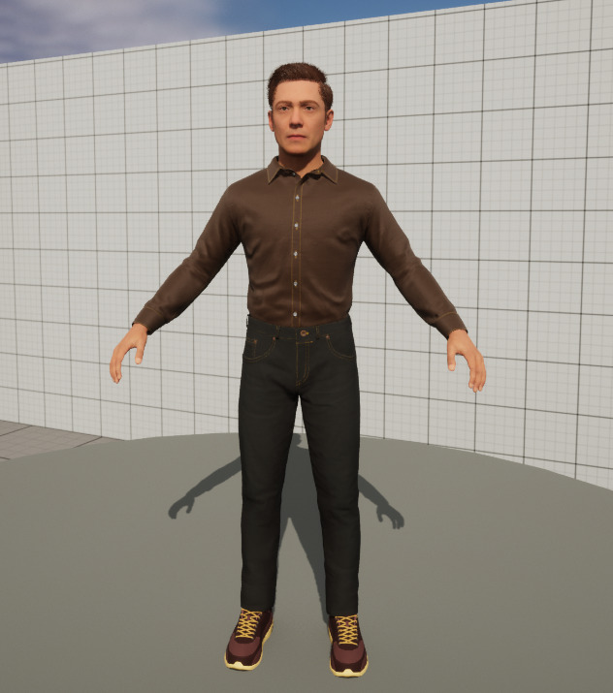
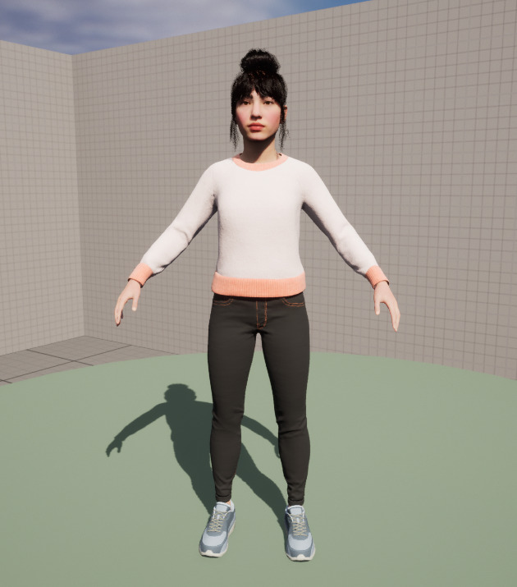
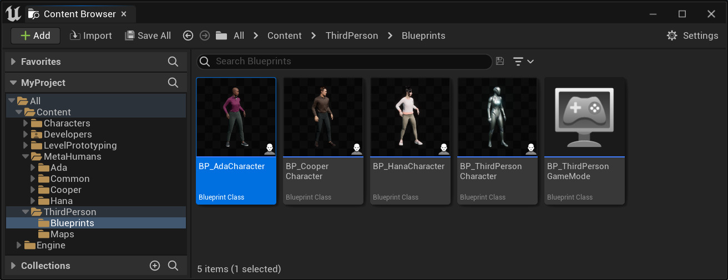

Slide 25
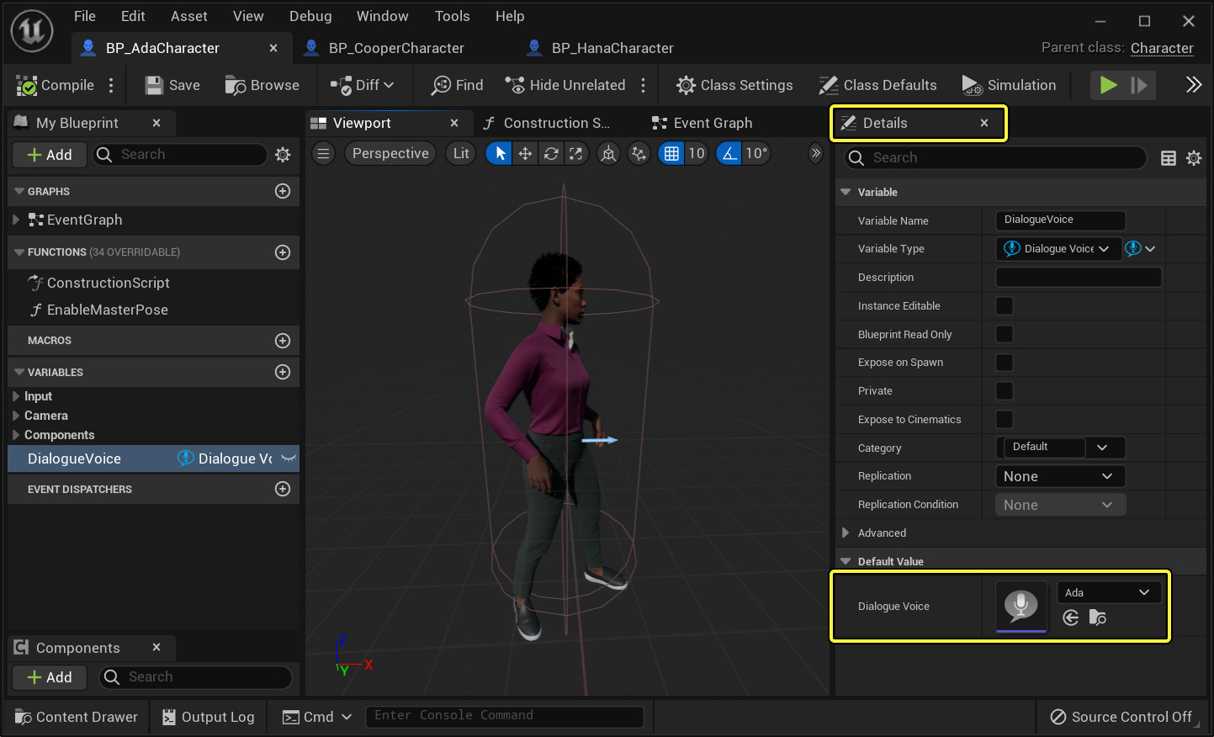

Slide 26
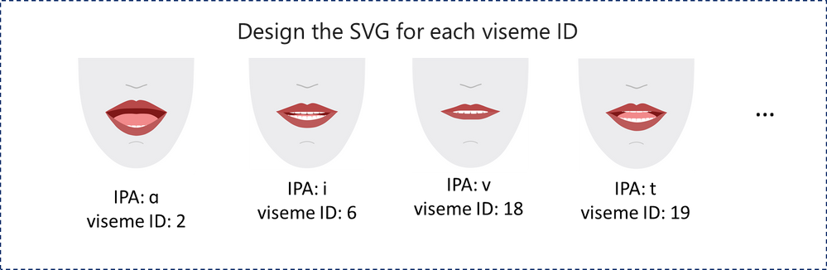
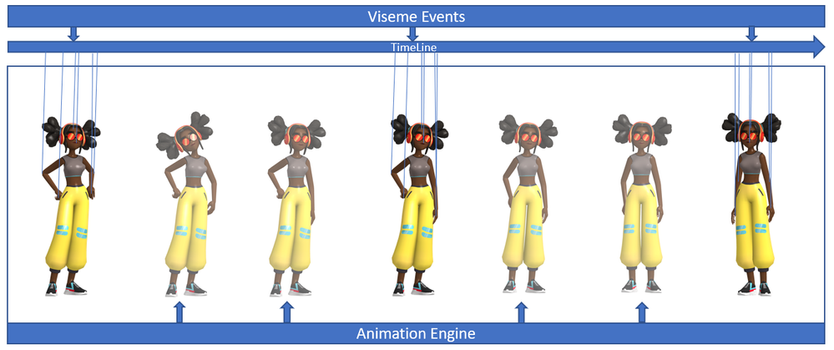
What AI problem/use-case does it solve? / Is it a good fit?
https://techcommunity.microsoft.com/t5/azure-ai-services-blog/azure-neural-text-to-speech-extended-to-support-lip-sync-with/ba-p/2356748

Slide 27
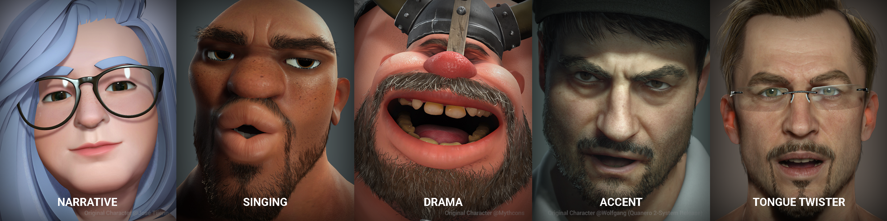

https://www.reallusion.com/iclone/lipsync-animation.html

Slide 28
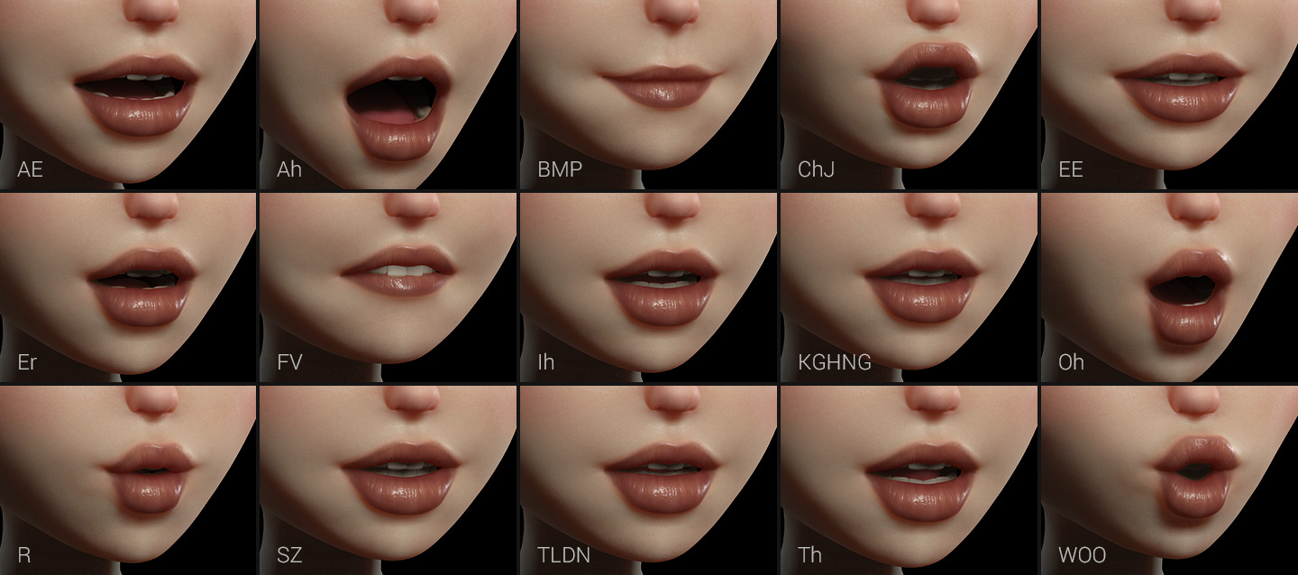
https://www.reallusion.com/iclone/lipsync-animation.html

Slide 29
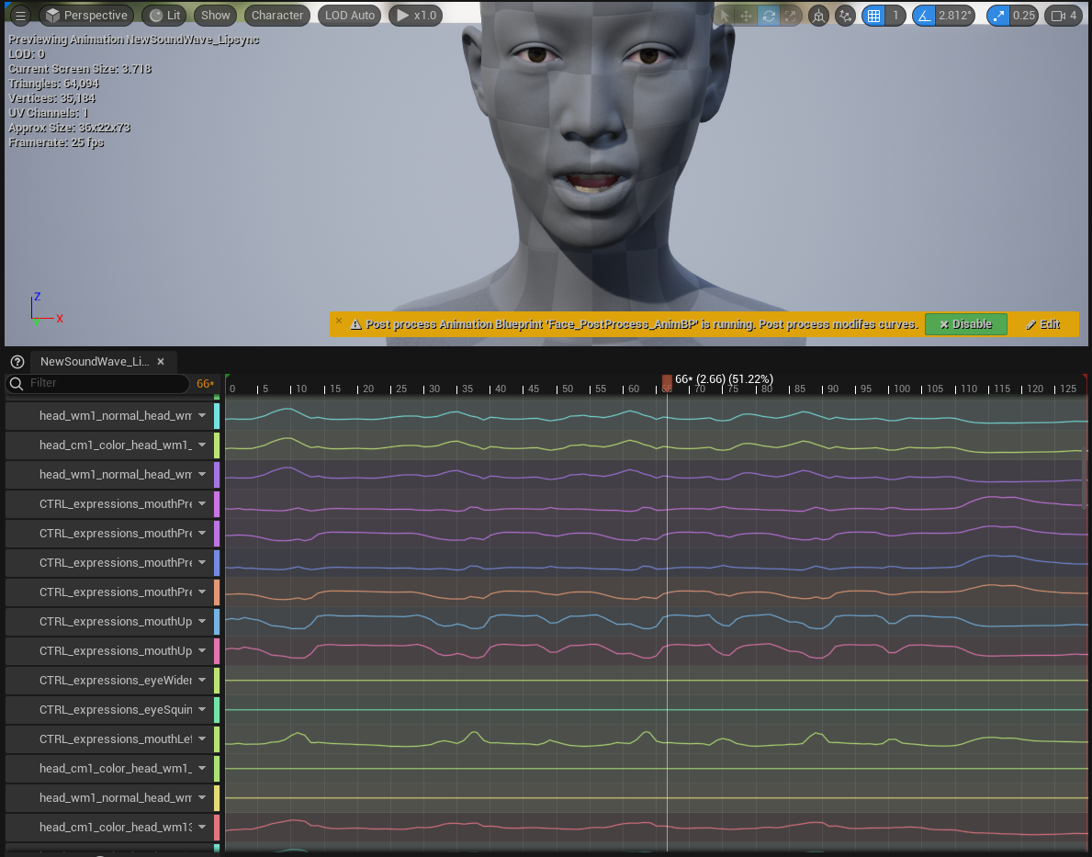

Slide 30

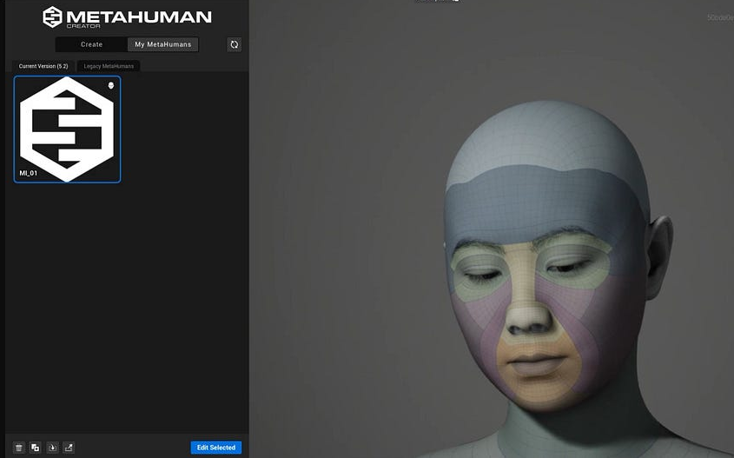
Designate the
Capability Domain &
Application Domain
MetahumanSDK is a Unreal Engine plugin
to Create real time
photorealistic avatars
in a matter of minutes …
Text to Speech
Audio Lip-sync
Chatbot engine (plugin)
Talk component
(learning)algorithm

Slide 31
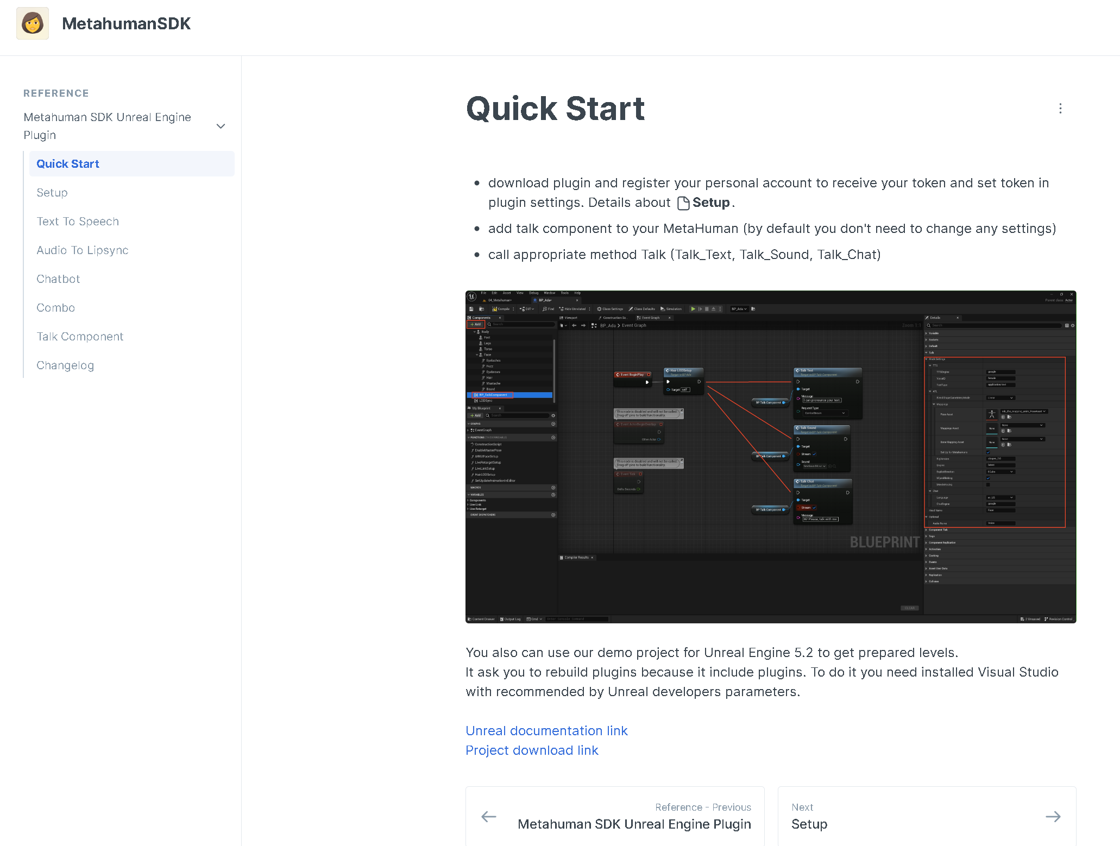
Description of
Data Product Components & Techniques
Involved
https://docs.metahumansdk.io/metahuman-sdk/reference/metahuman-sdk-unreal-engine-plugin/quick-start

Slide 32

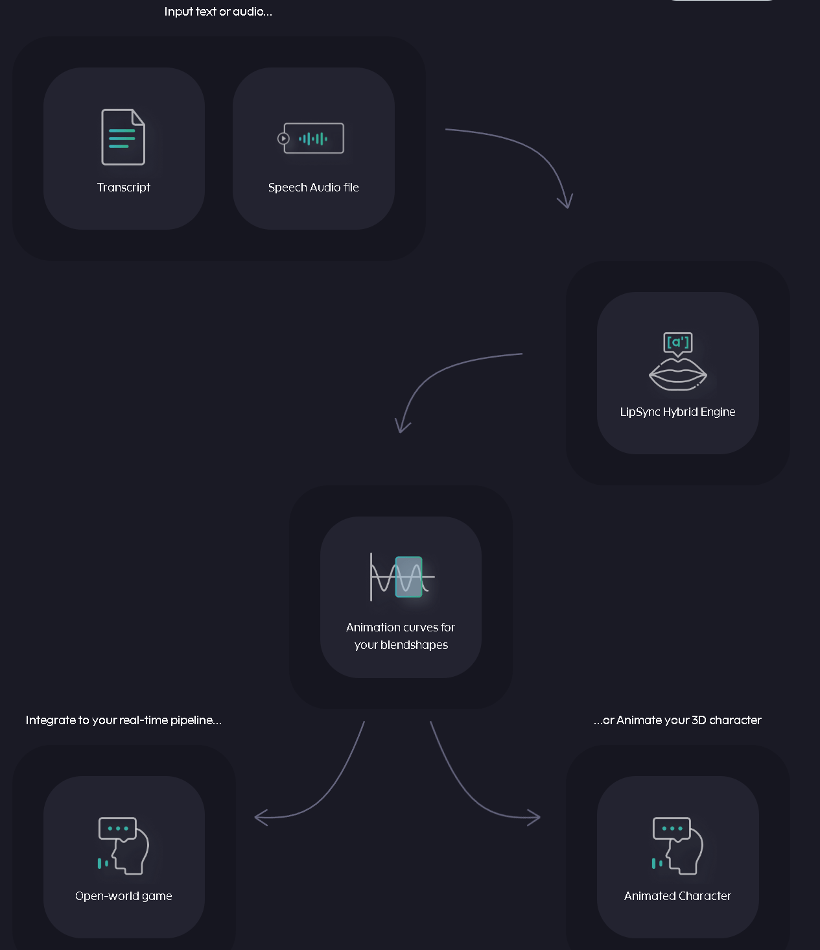
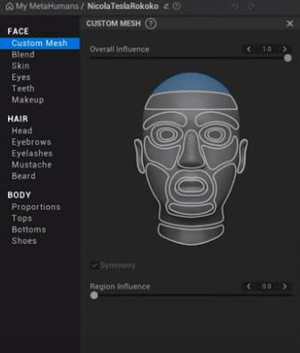
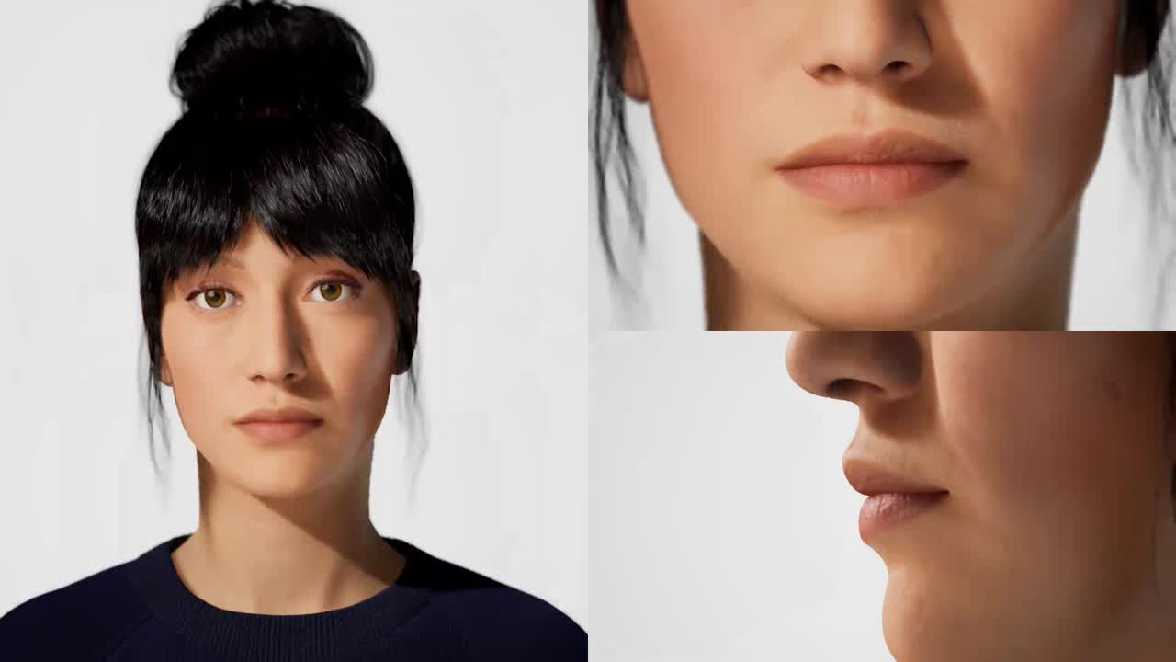

Slide 33
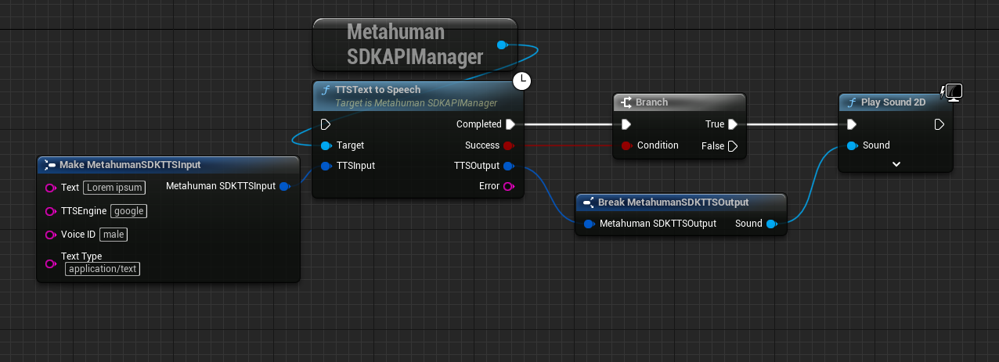
Model Description
https://docs.unrealengine.com/5.2/en-US/using-dialogue-voices-and-waves-in-unreal-engine/

Slide 34
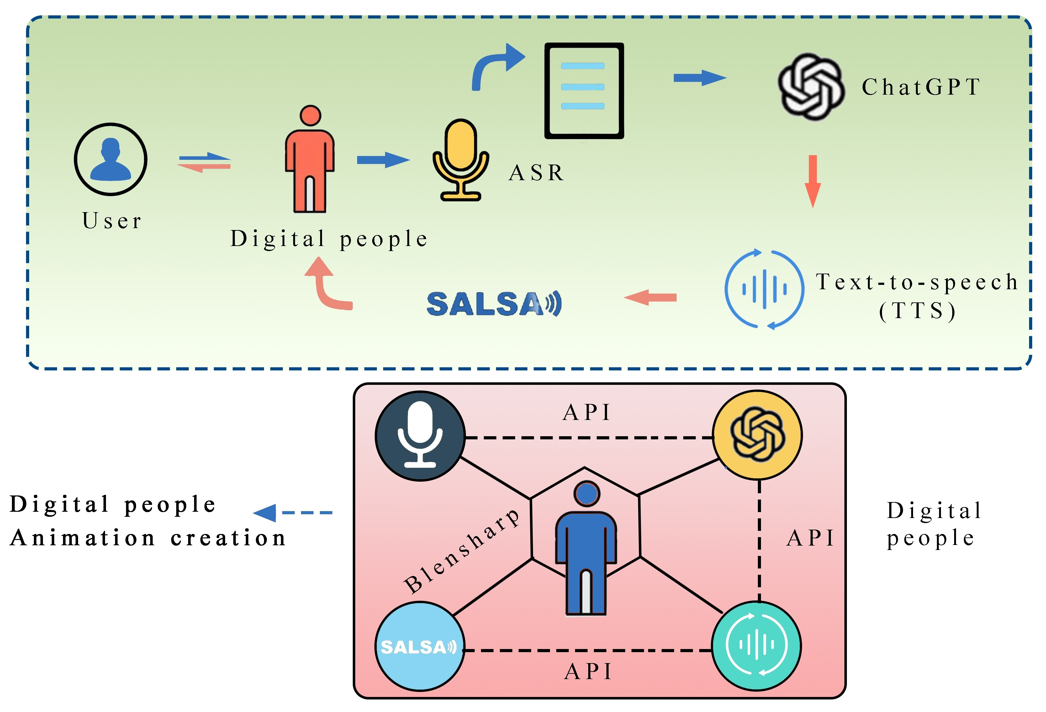
Lan C, Wang Y, Wang C, Song S, Gong Z. Application of ChatGPT-Based Digital Human in Animation Creation. Future Internet. 2023; 15(9):300. https://doi.org/10.3390/fi15090300

Slide 35
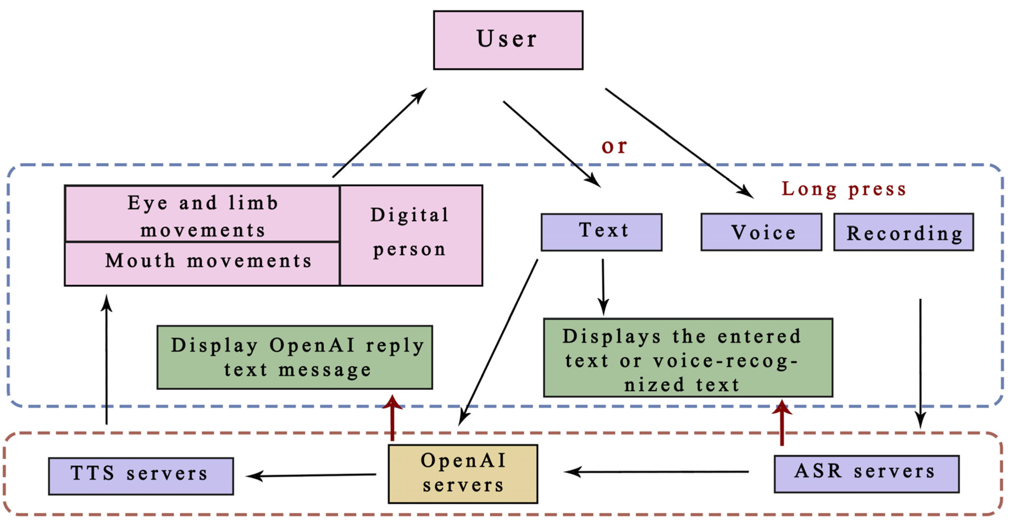
Lan C, Wang Y, Wang C, Song S, Gong Z. Application of ChatGPT-Based Digital Human in Animation Creation. Future Internet. 2023; 15(9):300. https://doi.org/10.3390/fi15090300

Slide 36

DIGTALE IMPLEMENTATIE
Digital human
DEMO UNREAL 5.2
MetaHumanTutorial-how to use the DSK
https://docs.unrealengine.com/5.2/en-US/using-dialogue-voices-and-waves-in-unreal-engine/

Slide 37
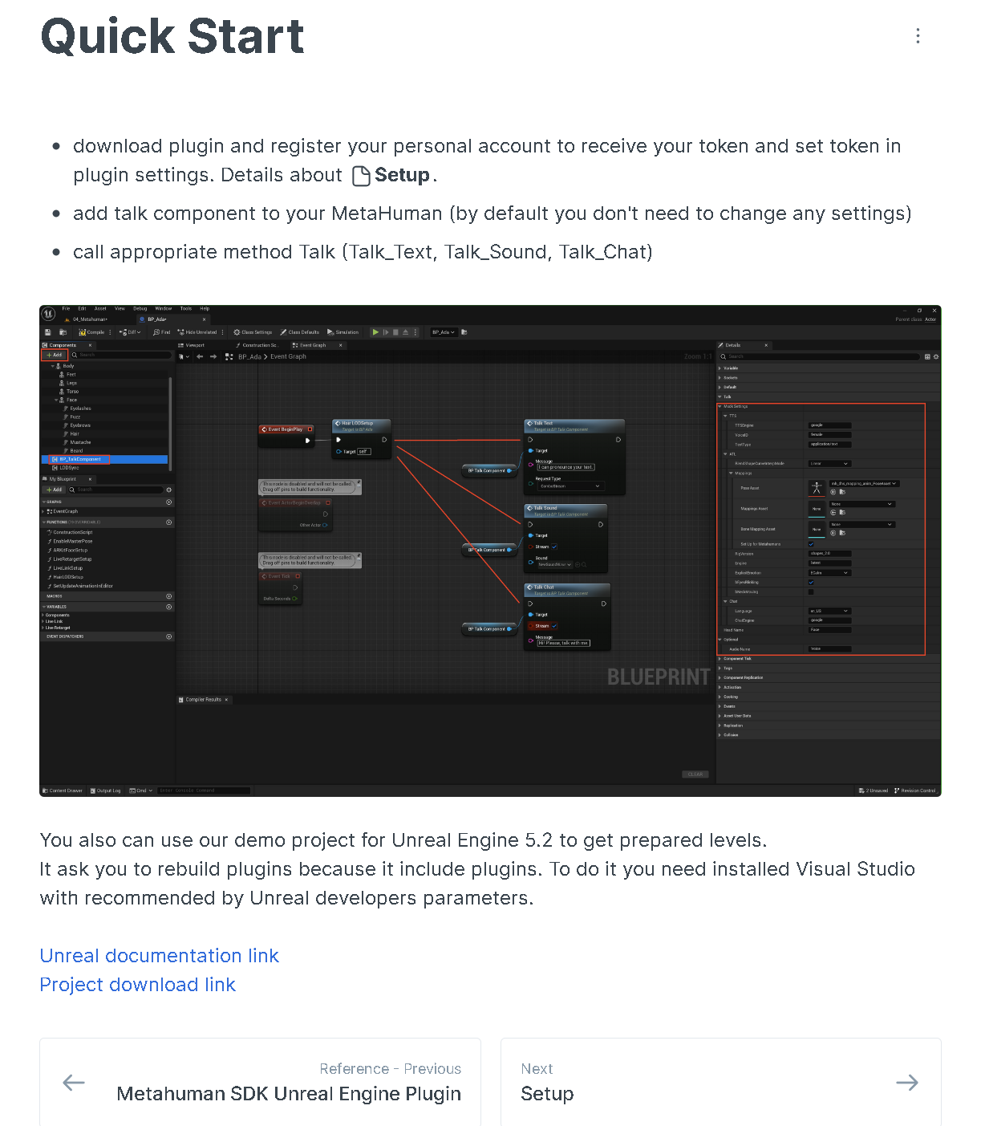


Slide 38
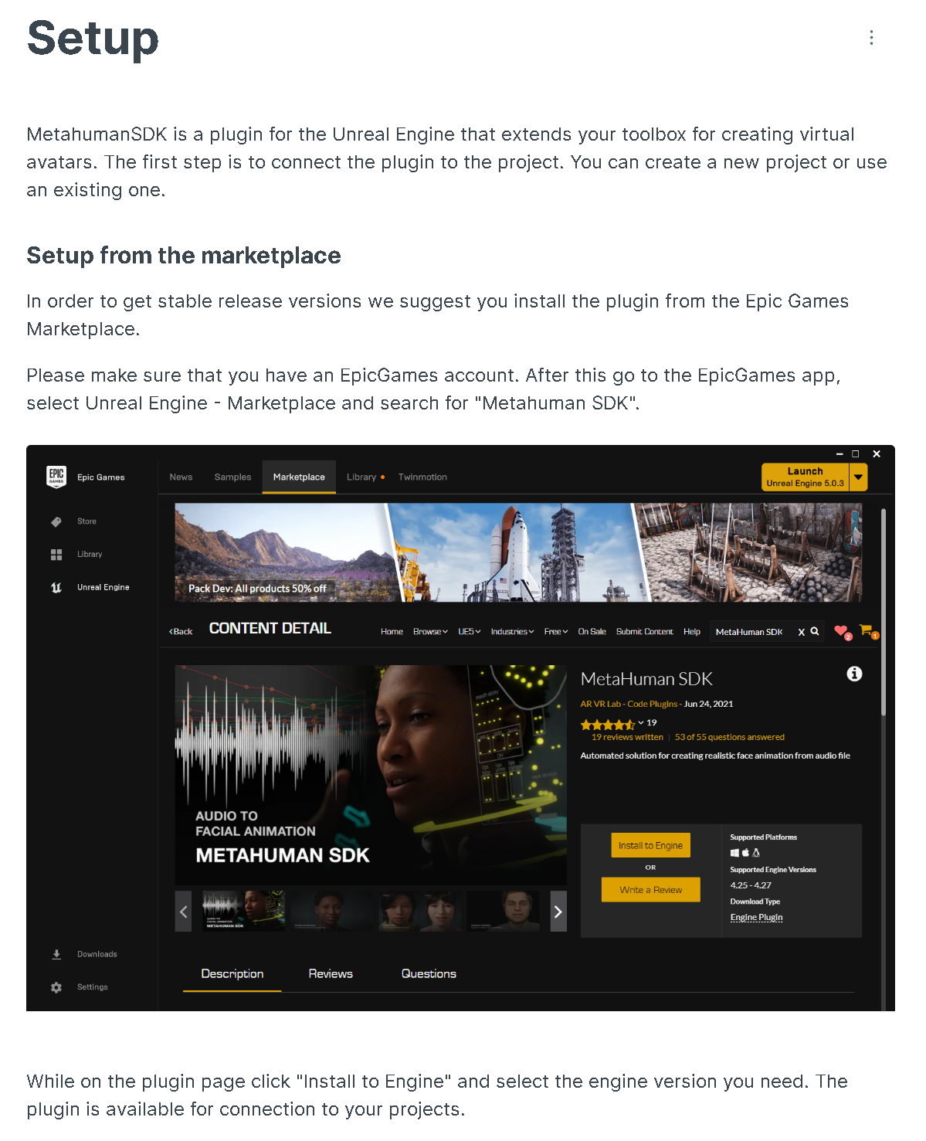

Slide 39
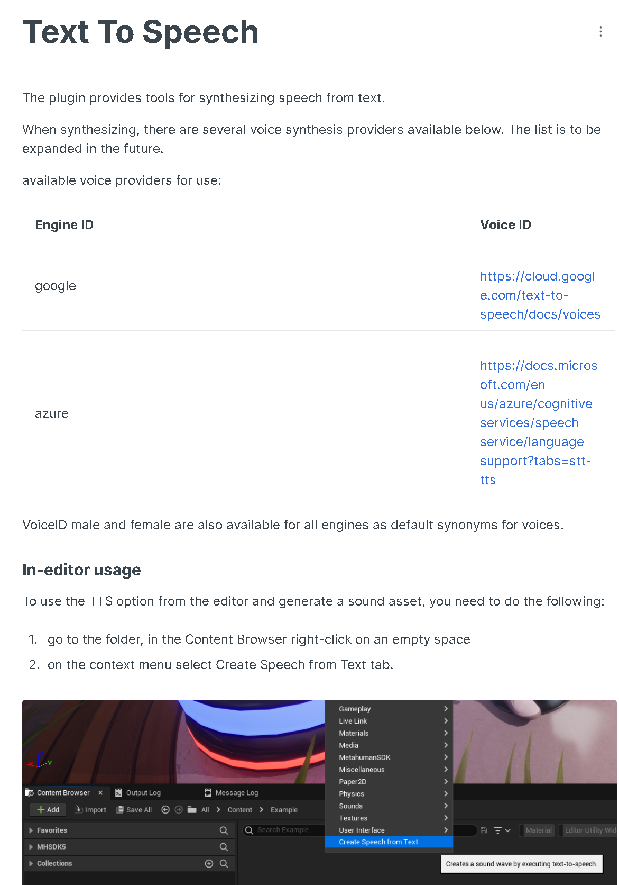

Slide 40
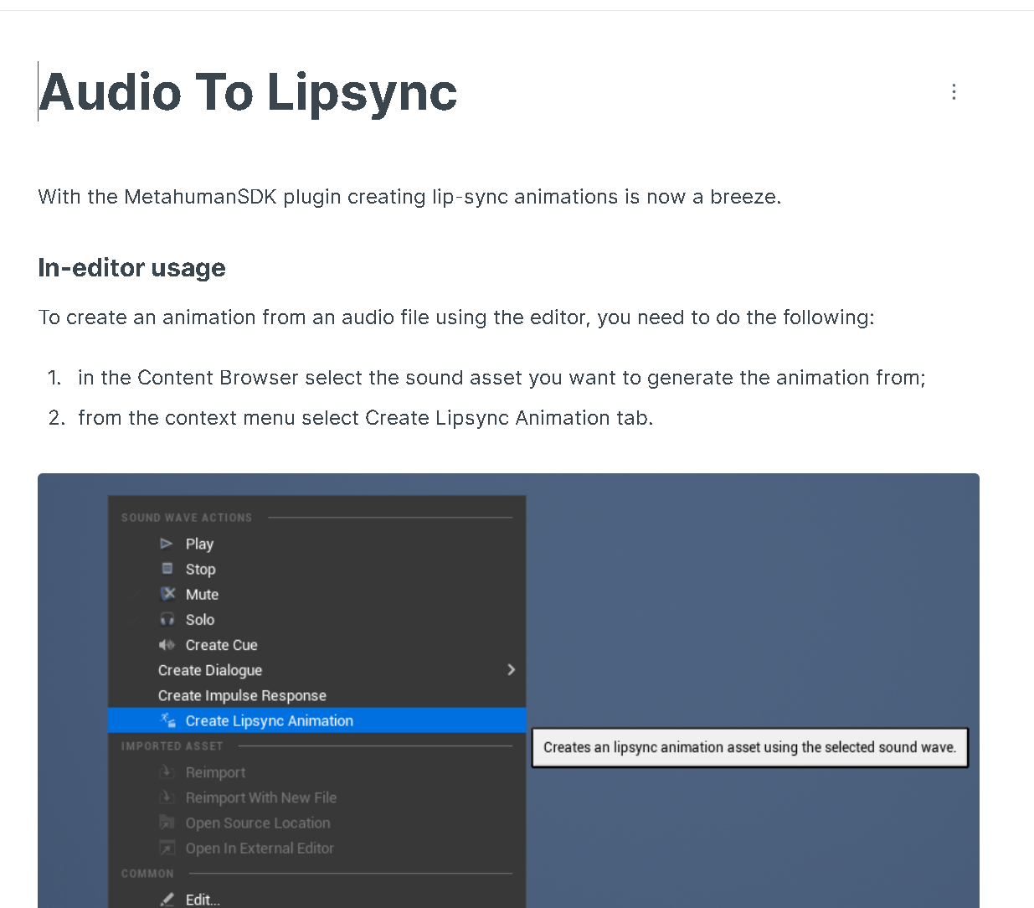
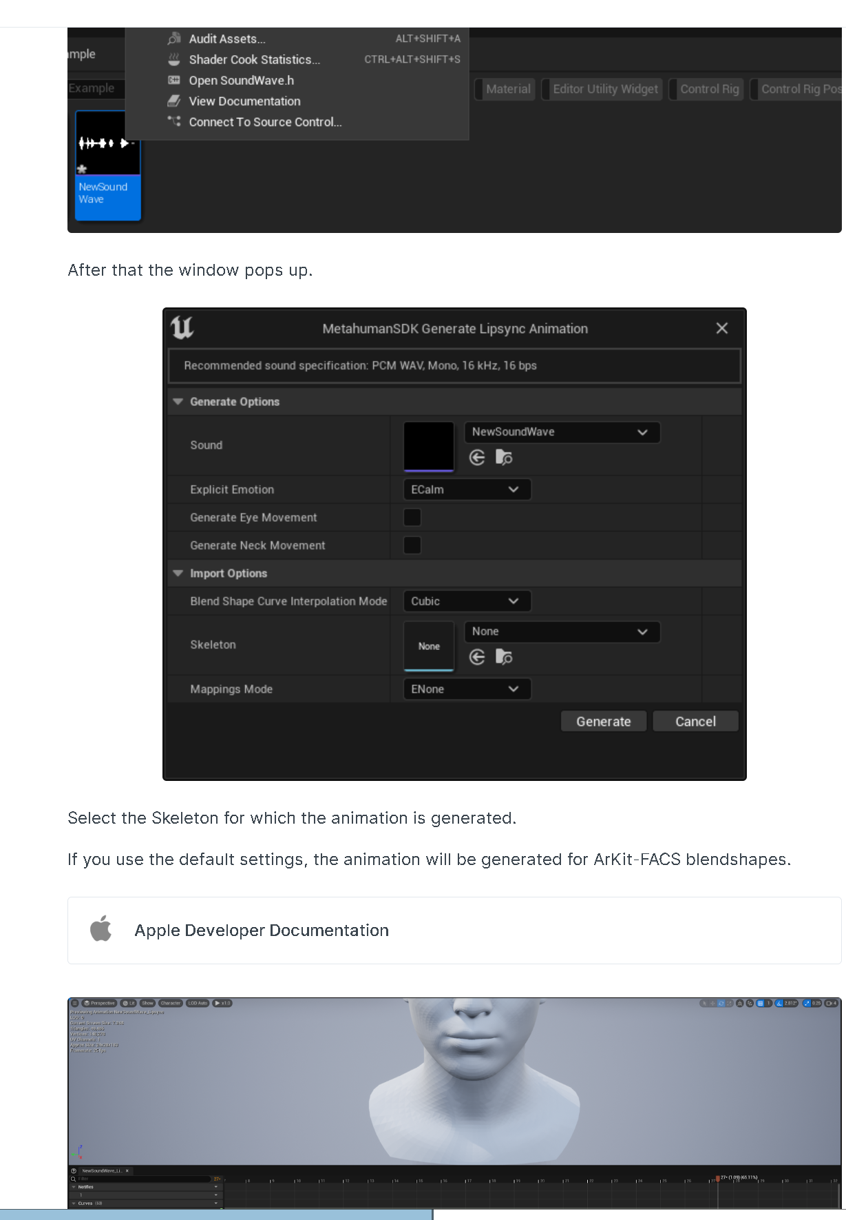

Slide 41
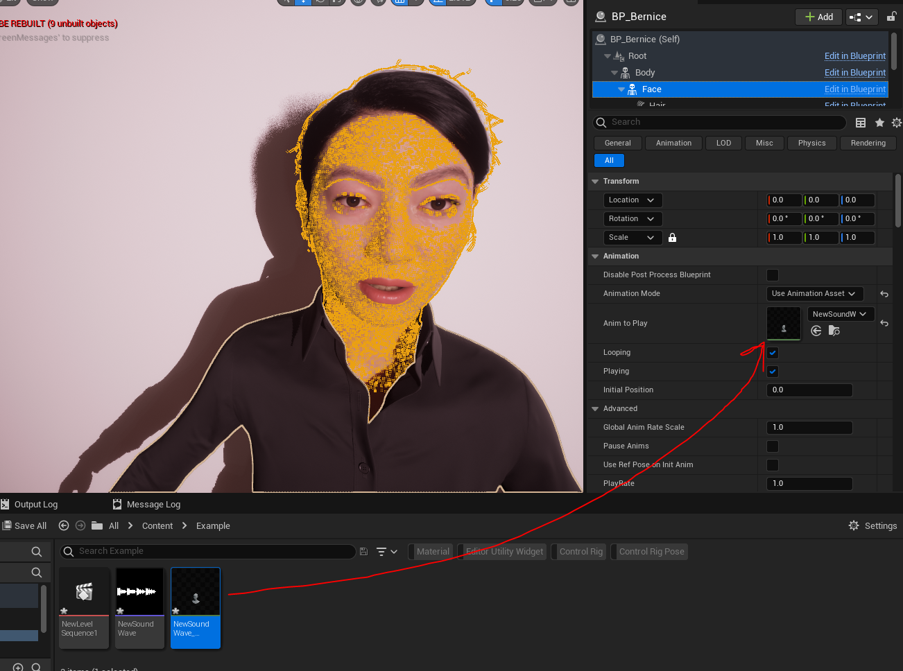

Slide 42
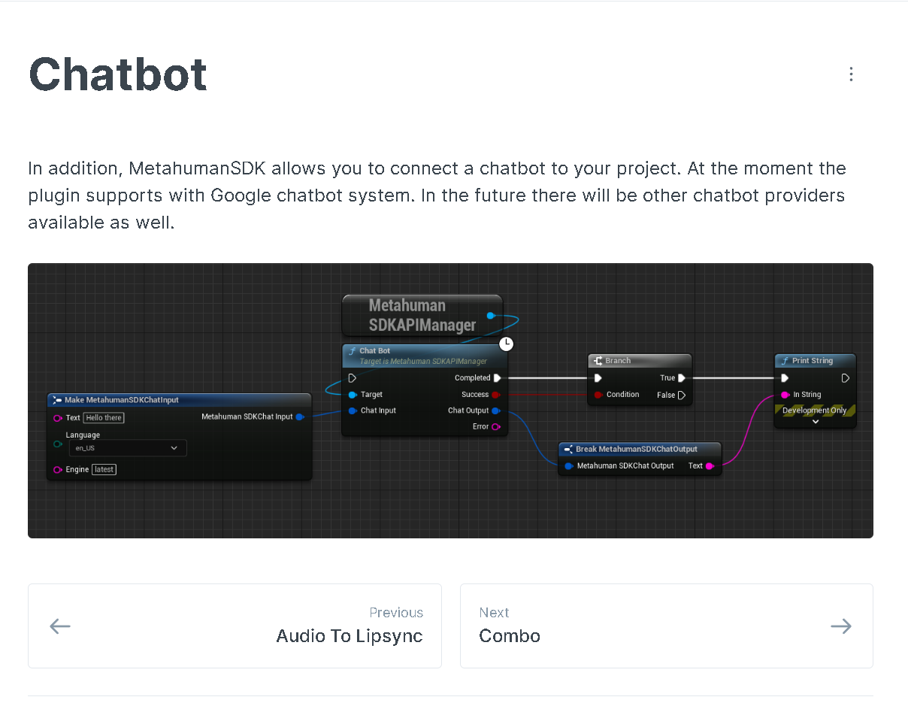

Slide 43
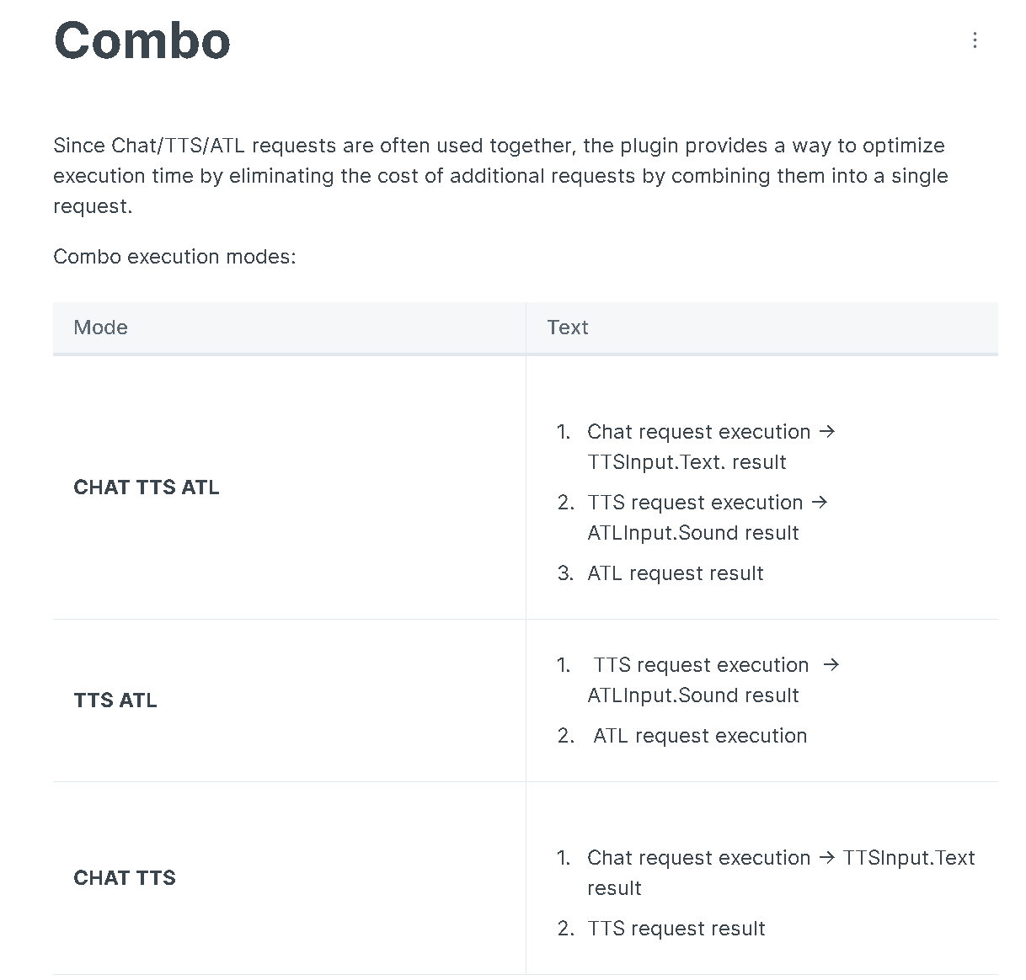
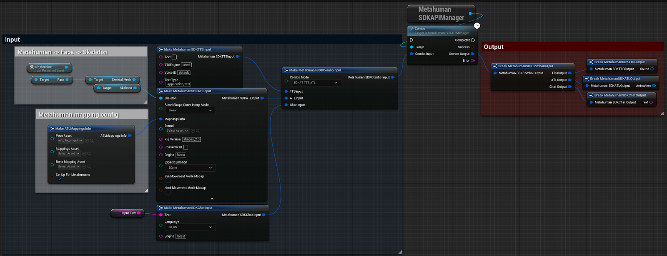

Slide 44
https://www.reallusion.com/iclone/
https://medium.com/@kzhao37/guide-to-set-up-and-use-metahuman-animator-in-unreal-engine-5-2-384401bfb3ea
https://medium.com/keentools/keentools-facebuilder-x-metahuman-guide-81bc193ef2a
MetaHumanTutorial-how to use the DSK
https://www.theverge.com/2023/3/22/23648834/metahuman-animation-epic-state-of-unreal-gdc-2023
https://www.magnopus.com/blog/unreal-engine-gdc-2023-metahuman-animator
https://medium.com/@twinsync.ai/lip-syncing-in-the-digital-world-the-key-to-diverse-applications-of-ai-generated-characters-4681fc39f54c

Slide 45
Digital Human Use Case Report structure
PART I
Problem Selection, Definition & Motivation + Human in the Loop
Define Artificial Intelligence (in your own words)
Define the 5 main characteristics (features) of AI
Defining Artificial Intelligence (in your own words)
Make your own info graphic/knowledge-map that gives an accurate overview of the state-of-the-art AI (see e.g., https://www.nesta.org.uk/report/future-minds-
and-machines/2-what-artificial-intelligence/)
PART II
Digital Human as a data product
Defining Digital Human as a Conversational Agent (in your own words)
What AI problem/use-case does it solve? / Is it a good fit?
Designate the Capability Domain & Application Domain
Description of Data Product Components & Techniques Involved
Describe the Graphical User-interface
Describe the Multimodal (audio-visual) Appearance / Look & Feel
Describe the AI-model in terms of its Agency and Architecture
Describe the learning algorithm (LM)
Describe how it is trained
Describe the parameters involved

Slide 46
Digital Human Use Case Report structure
PART III
Use Case Description & Application
Give a short overview of the most popular Digital Human use cases
+ short description (in your own words)
Find examples of
Assistance
Companionship
Conversational Exchange
Theory-of-Mind
Social Influencing
o
Describe, demonstrate, and analyse each of use-cases in terms of:
Prompt engineering techniques
Human-Computer Interaction (HCI) principles
Performance level / Accuracy
Parameter setting
PART IVI
Critical Reflection & Ethical Considerations
Assess popularity / “ground-breaking” aspects
Evaluate whether the AI data product solves the problem at hand
Review potential issues & existing documentation in relation to the European AI-act
Studied Literature
Select 3 review articles, describe in your own words their relevance
Provide an APA-style overview of the sources used to write your AI-report

Slide 48


